Slide 1
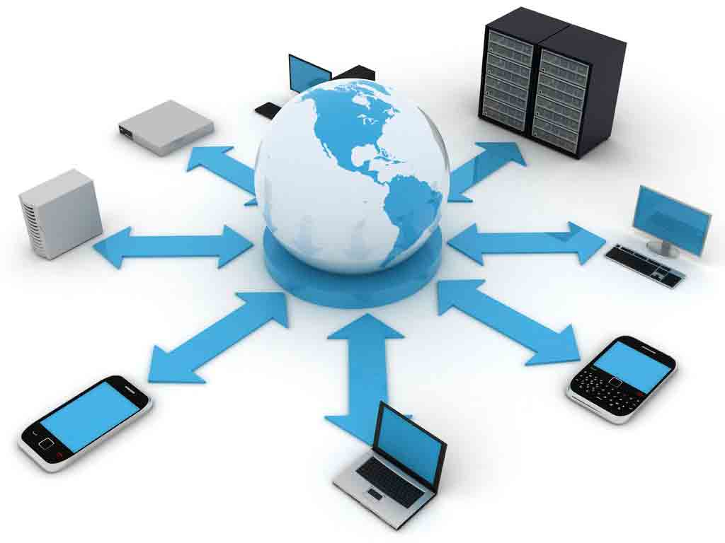
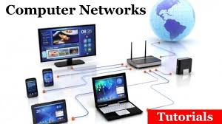
UE17MC502
UE17MC502

Slide 2
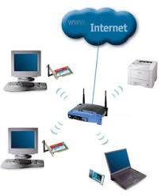
UNIT-1
Computer Networks and the Internet

Slide 3
Computer Network
Overview of the internet
The Network edge—Access N/Ws, Physical media
The Network core---packet circuit Switching
Delay , loss, throughput
Protocol layering
3

Slide 4
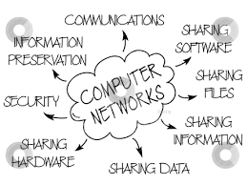
Computer Network
Network of computers.
A computer network means where a number of computers are linked together. It allows them to share resources with others.

Slide 5
Computer Network
Network is the interconnection of a set of devices capable of communication.
Devices are
> Computing Devices - end systems or hosts.
Connecting Devices –routers, switches and modems.
The computers on a network may be linked through cables, telephone lines, radio waves, satellites.
Networking involves installing network cards in each computer.

Slide 6
Connecting Devices
Each computer is connected through cabling or wirelessly to a central device called a Hub.
Router-Which connects the network to other networks.
Switch—which connects devices together.
Modem(modulator-demodulator) that changes the form of data.

Slide 7









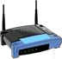
Computer Network
millions of connected computing devices:
hosts = end systems
Billion of users
PC
server
wireless laptop
smartphone
PC, laptops, tablets, Smartphones, ipads, Sensors, webcams,
Game consoles, Picture frames, TVs etc.
communication links
Fiber optics, Coaxial cables
Radio, satellite
Transmission rate: bandwidth
wireless
links
wired
links

Slide 8
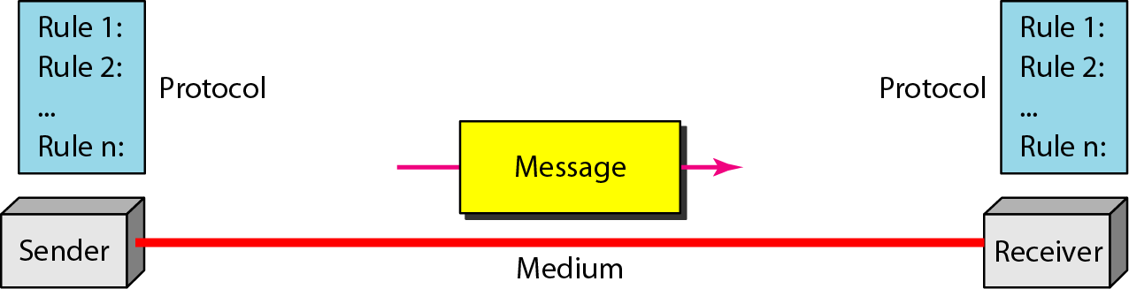
Five components of data communication

Slide 9
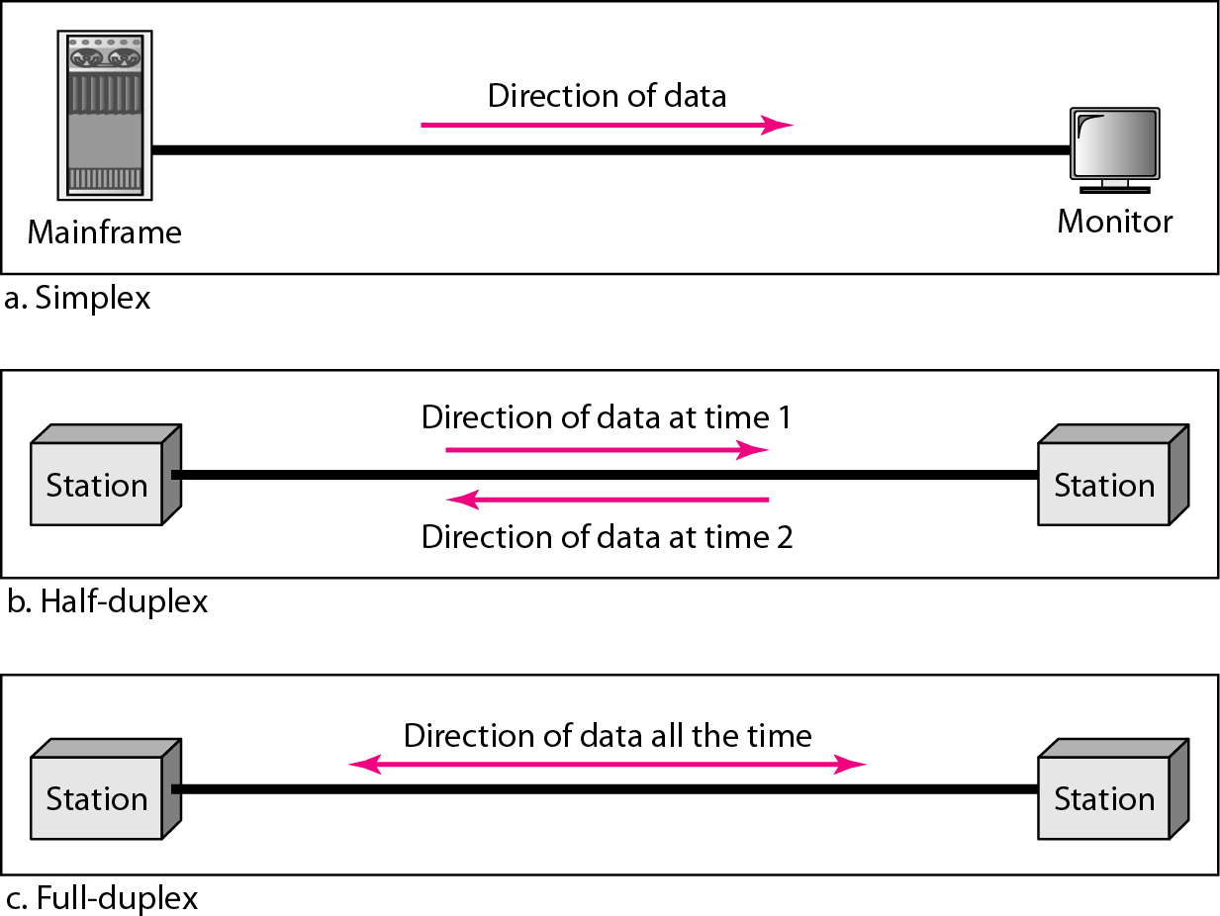
Data flow (simplex, half-duplex, and full-duplex)

Slide 10
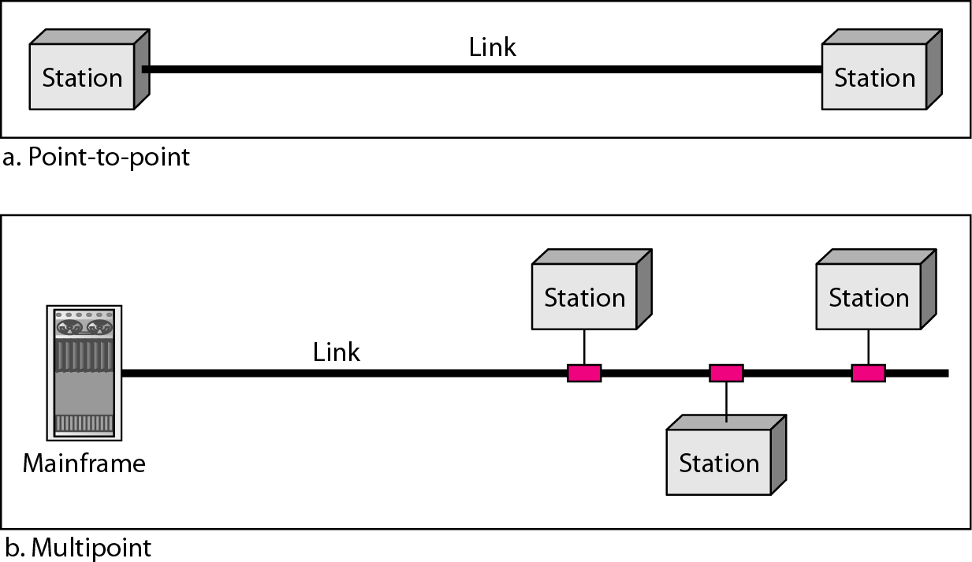
Types of connections: point-to-point and multipoint

Slide 11
Categories of Networks
Networks are distinguished based on their geographical span.
PAN-- Personal Area Network
LAN – Local Area Network
MAN --Metropolitan Area Network
WAN – Wide Area Network
(Wider geographical area)

Slide 12
1.Personal Area Network
A Personal Area Network (PAN) is smallest network which is very personal to a user.
This may include Bluetooth enabled devices or infra-red enabled devices.
PAN has connectivity range up to 10 meters.
PAN may include wireless computer keyboard and mouse, Bluetooth enabled headphones, wireless printers and TV remotes.

Slide 13
2.Local Area Network
LANs are basically used to connect a limited geographical area.
Normally privately owned, single office, building, campus etc.
LANs are usually owned, controlled, and managed by a single person or any organization.
LANs can span over a limited range i.e. of 1 km in radius.
Purpose – resource sharing. The resources such as printers, file servers, scanners, and internet are easily sharable among computers.
LAN can be wired, wireless.

Slide 14
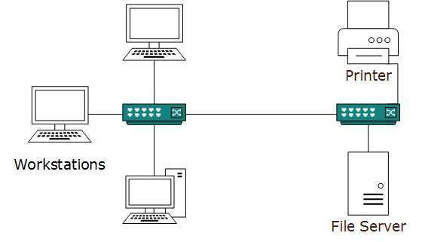
LAN

Slide 15
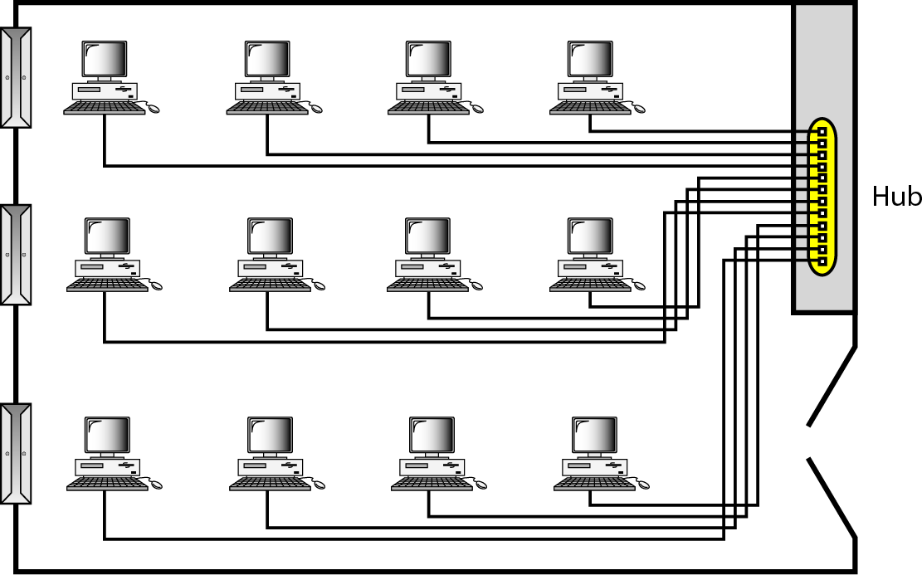
An isolated LAN connecting 12 computers to a hub in a closet
Early LANs
Todays LAN - Hub replaced by a smart Switch

Slide 16
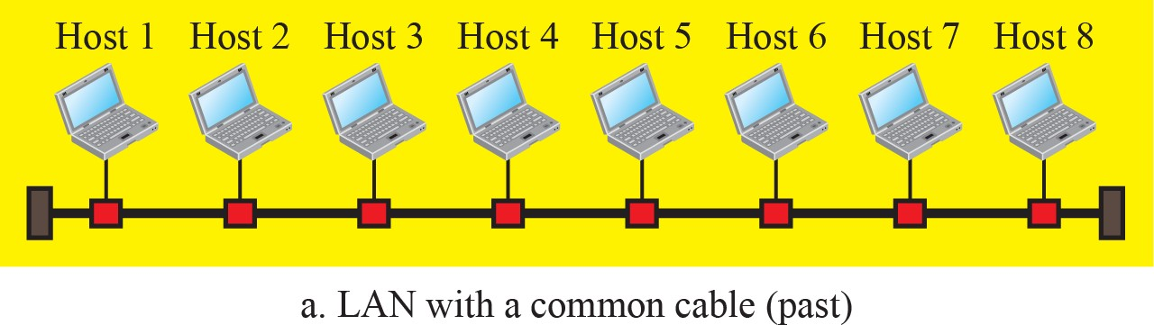
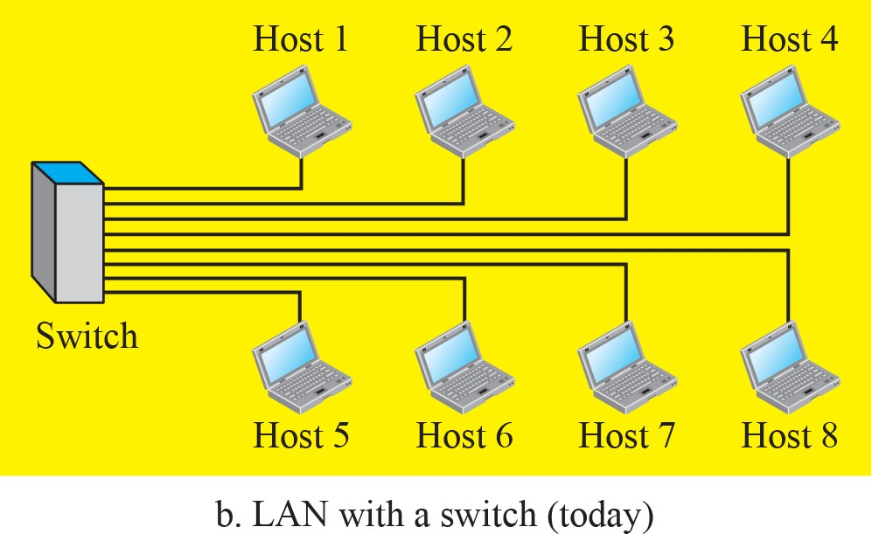
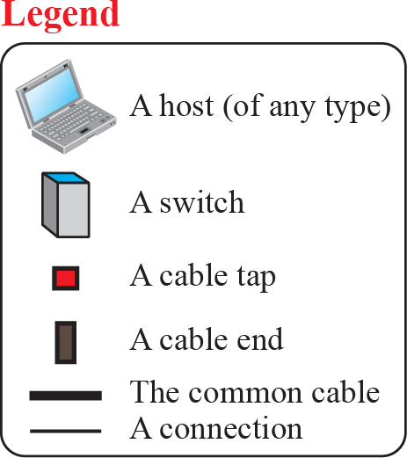
An Isolated LAN in the past and today

Slide 17
3.Metropolitan Area Network
It is used to connect two or more LANs in a common geographic area: say a city or a group of buildings.
MANs can span in the range of 5 to 50 kilometers in diameter.
MANs usually are not owned by a single organization, they are owned by an association of users or by a single network provider who sells the service to the users.
MAN can be considered as a larger version of a LAN which allows users to share resources at a greater span of distance as compared to LAN.

Slide 18
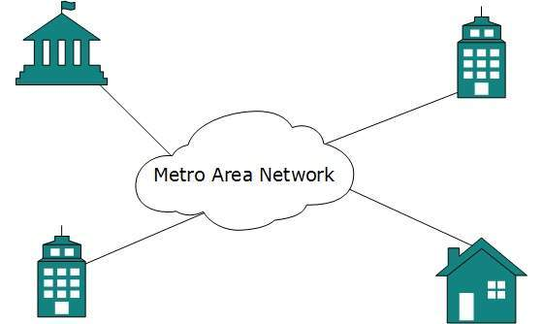
MAN
For example, MAN can help an organization to connect all of its offices in a city.
Backbone of MAN is high-capacity and high-speed fiber optics.
MAN works in between Local Area Network and Wide Area Network.

Slide 19
4.Wide Area Network
WANs are typically used to connect comparatively large geographical area .
such as; a state, a country, a continent, the Internet.
WANs can span over a range of huge area of 100,000 kilometer radius (between the Earth and artificial satellites).
Generally, telecommunication networks are Wide Area Network.
WANs have its ownership and management is distributed it cannot be handled at individual level.
WAN may be managed by multiple administration.

Slide 20
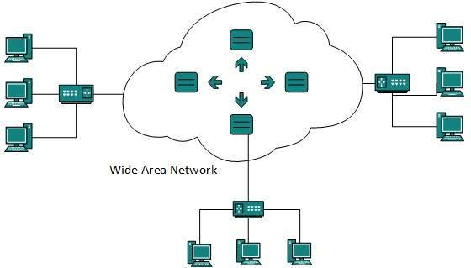
WAN

Slide 21
Types of WAN
1.Point-to-point WAN---Which connects two communicating devices through a transmission media(cable/air).
2.Switched WAN---A switched WAN is a network with more than two ends.
It is a combination of several point-to-point WANs that are connected by switches.

Slide 22
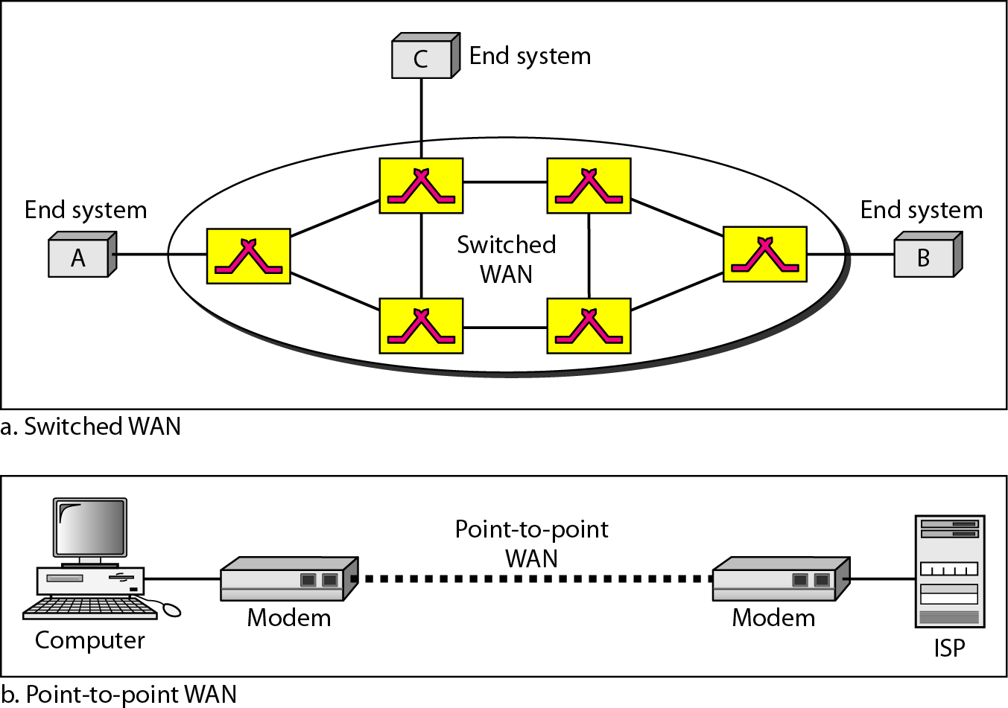
WANs: a switched WAN and a point-to-point WAN

Slide 23
Internetwork
When two or more networks are connected, they make an internetwork or internet.
A network of networks is called an internetwork, or simply the internet.
It is the largest network in existence on this planet.
The internet hugely connects all WANs and it can have connection to LANs and Home networks.
Internet uses TCP/IP protocol suite and uses IP as its addressing protocol.

Slide 24
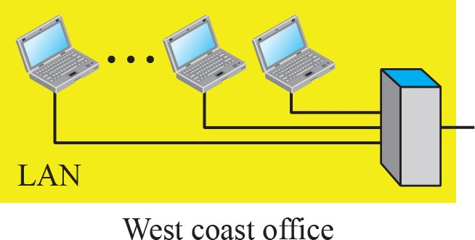
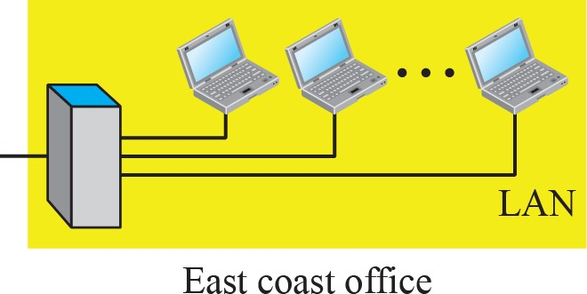
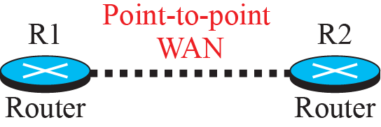
An internetwork made of two LANs and one WAN

Slide 25
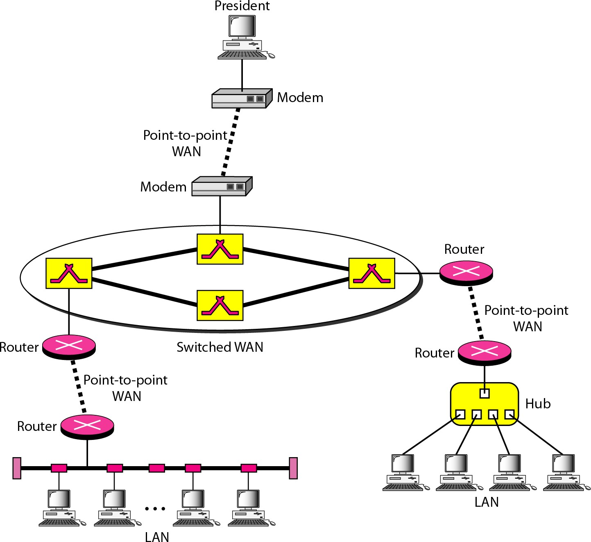
Heterogeneous network--- 4 WANs and 3 LANs
Computer Networks and the Internet
18

Slide 26
Switching
Switching is a process to forward packets coming in from one port to a port leading towards the destination.
An internet is a switched network in which a switch connects at least two links together. A switch needs to forward data from a link to another link when required.
The 2 most common types of switched networks are
1. Circuit-switched network
2. Packet-switched network

Slide 27
Circuit Switched Network
A circuit-switched network is made of a set of switches connected by physical links, in which each link is divided into n channels.
In circuit switching, the resources need to be reserved during the setup phase; The resources remain dedicated for the entire duration of data transfer until the teardown phase.
Switching at the physical layer in the traditional telephone network uses the circuit-switching approach.

Slide 28

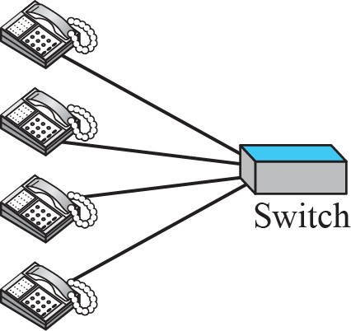
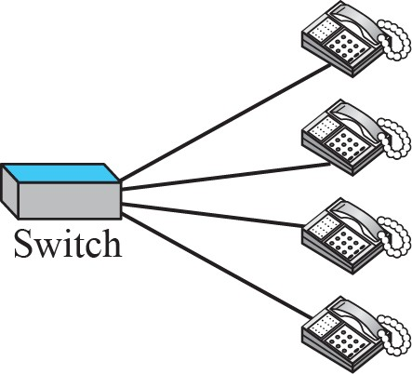
A circuit-switched network

Slide 29
Packet Switched Networks
In a packet-switched network, there is no resource reservation;
Resources are allocated on demand.
A switch uses the store and forward concept (queues).
A switch (layer-3) uses a routing table that is based on the destination address.
Switching in the internet is done by using the packet switching at the network layer.

Slide 30

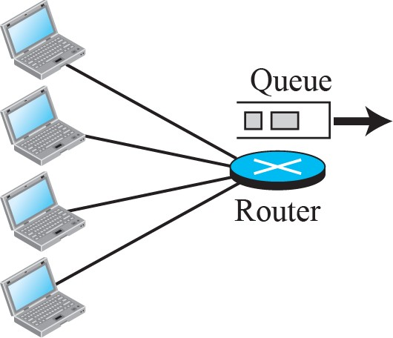
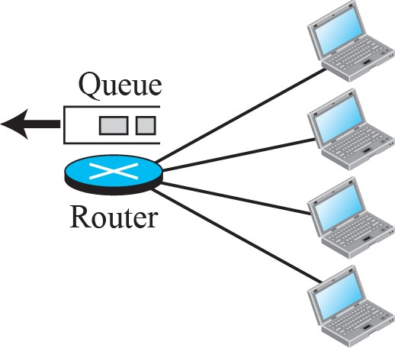
A packet-switched network

Slide 31
S witching
Circuit Switching – dedicated connection between two endpoints, always available.
Packet Switching – uses blocks of data called packets, uses store and forward technique.
Analogy – Telephone Network and postal System.

Slide 32
Switching
Packet switching is more efficient than circuit switching.
Packets may encounter some delays.

Slide 33
The Internet
“network of networks”
Interconnected I S Ps
Internet is a combination of links, Switches and Routers
It is a switched network in which a switch connects at least two links together.
Figure shows a conceptual(not geographical) view of the internet.

Slide 34
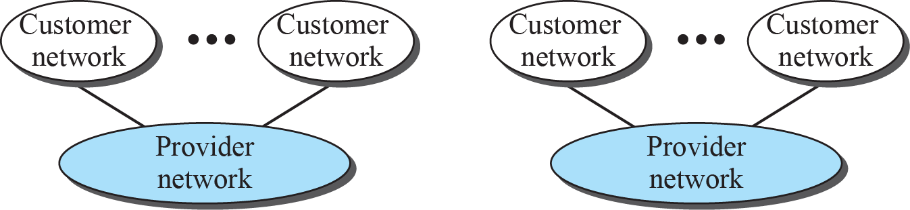
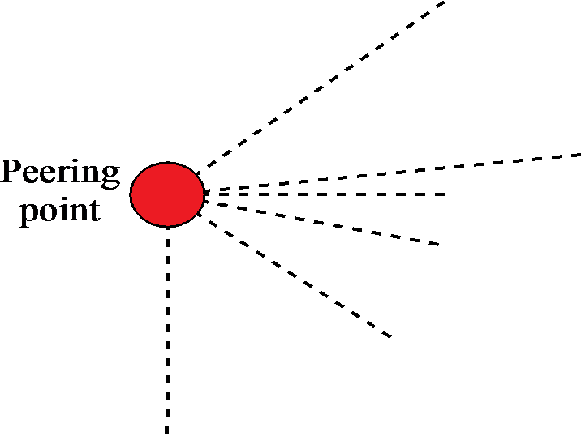
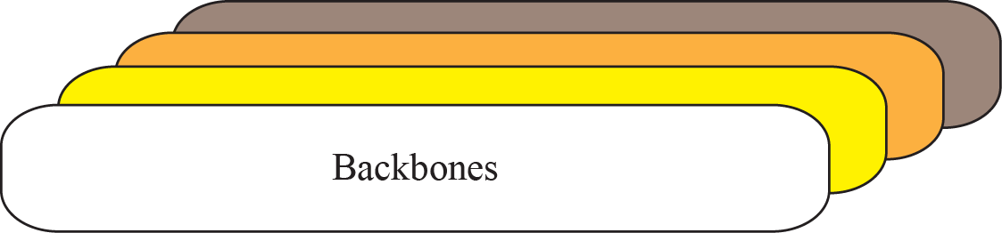
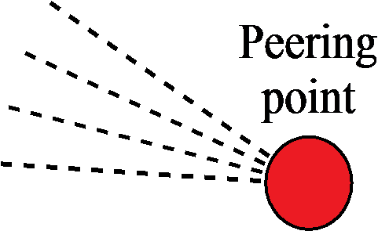
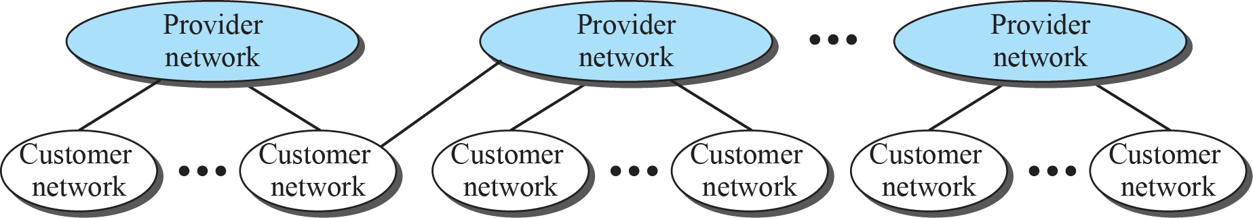
The Internet today

Slide 35
The Internet
The internet as several backbones, provider networks and customer networks.
Backbones—These are large networks owned by some communication companies such as Sprint, Verizon, AT&T and NTT.
The backbone n/ws are connected through some complex switching systems, called peering points.

Slide 36
Provider networks– At the second level, there are smaller networks, called provider networks.
Use the services of the backbones for a fee.
The provider networks are connected to backbones and sometimes to other provider networks.
Customer networks—These are networks at the edge of the internet that actually use the services provided by the internet.
They pay fees to provider networks for receiving services.
Backbones, Provider networks---Internet Service Providers(ISPs). International ISPs—Backbones, National /Regional ISPs—Provider networks
Notes:
TATA

Slide 37
Accessing the Internet
Using Telephone networks – dial-up, D S L
Using Cable networks
Using wireless networks
Direct connection to the internet

Slide 38
Using Telephone networks
Residences and small businesses have telephone service, they are connected to a telephone network.
Telephone networks already connected to internet.
This can be done in 2 ways
1.Dial-up service
2. DSL service(Digital Subscriber Line)

Slide 39
1.Dial-up service—add to the telephone line a modem that converts data to voice. The software installed on the computer dials the ISP and imitates making a telephone connection.
Very slow
When line is used for internet, it cannot be used for telephone(voice) connection.
Only useful for small residences, business with occasional connection to the internet.
2.DSL Service-- Upgrading telephone lines to provide high speed internet services,
Line to be used simultaneously for voice and data.

Slide 40
Using Cable networks
Using cable TV services instead of antennas to receive TV broadcasting.
The cable companies have been upgrading their cable networks and connecting to the internet.
It provides a higher speed connection

Slide 41
Using Wireless Networks
Recently become increasingly popular
Small business can be connected to the internet through a wireless WAN.
Direct connection to the internet
A large organization can itself become a local ISP and be connected to the internet.
Eg—A university with several campuses can create an internetwork and then connect the internetwork to the internet.

Slide 42
A closer look at network structure: Network Edge
network edge:
hosts: two types - clients and servers
servers often in data centers
A client program running on one end system requests and receives the service from a server program on another end system.
They are distributed applications.
Most applications today are P2P in nature.
End systems acts as clients and servers
access networks: wired, wireless communication links that connects an end system to an edge router

Slide 43
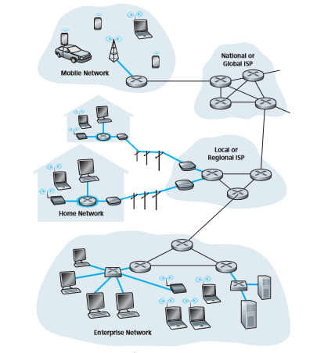
A c c e s s networks

Slide 44
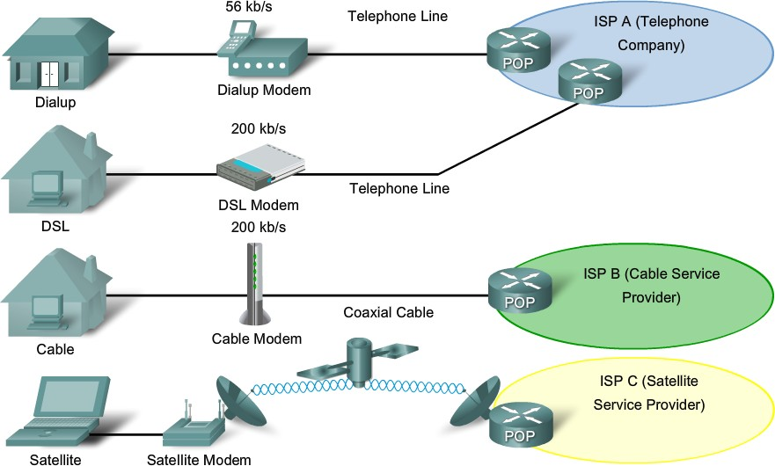

Slide 45
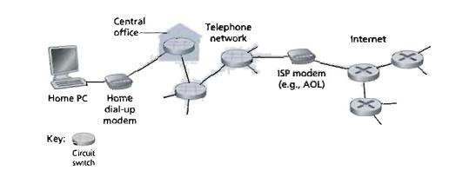
Dial-Up
Technology used in 1990s (Today rural areas,ddeveloping countries use
this technology)
Use analog telephone lines using dial-up modem.(twisted pair copper wire)
use existing telephone line to access the Internet

Slide 46
Dial-Up
The home modem converts the digital output of the PC into an analog format appropriate for transmission over the analog phone line.
At the other end of the connection, a modem in the ISP converts the analog signal back into digital form for input to the ISP’s router.
Two drawbacks:
Very slow (Max 56 kbps)
Phone calls and surfing the internet can not be done simultaneously.

Slide 47









Digital Subscriber Line (DSL)
central office
telephone network
DSL
modem
splitter
DSLAM
ISP
voice, data transmitted
at different frequencies over DSL access dedicated line to central office multiplexer
Popular in Europe (more than 90%).
Most of the developed countries use more than 50% broadband access.

Slide 48
Digital Subscriber Line (DSL)
use existing telephone line to central office DSLAM (twisted pair copper wire)
data over DSL phone line goes to Internet
voice over DSL phone line goes to telephone net
Both data and telephone signals are encoded at different frequencies.

Slide 49
DSL
Ordinary 2 way (full duplex) telephone channel in 0 to 4 kHz band
Medium speed upstream channel, in 4 kHz to 50 kHz band (128kbps – 1 Mbps range)
High speed downstream channel, in 50 kHz to 1MHz band (1 -2 Mbps range)

Slide 50
DSL
It has two major advantages compared to dial- up
It can transmit data at much higher rates.
Phone calls and surfing the internet can be done simultaneously. Using splitter
Now a days VDSL (very high speed DSL)is also available – it provides 12 – 55 Mbps for downstream and 1.6 – 20 Mbps for upstream
47

Slide 51
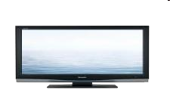




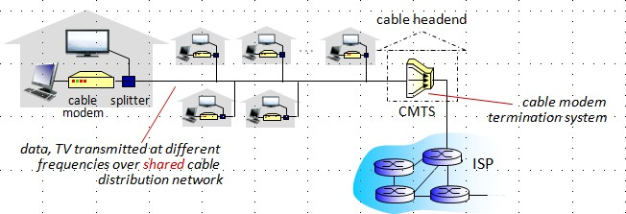
Access net: cable network
cable headend
…
cable
splitter
modem
Popular in North America
Same cable network is used for internet access
frequency division multiplexing: different channels transmitted
in different frequency bands from cable headend to residences

Slide 52
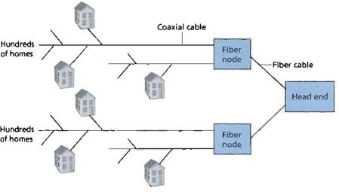
Access net: cable network (HFC)
Hybrid fiber – coaxial access network
Fiber optics connects the cable head end to neighborhood level junctions coaxial cable to connect to individual homes (HFC - connecting 500 -5000 homes)

Slide 53
Both fiber and coaxial cable are employed in this system— Hybrid Fiber Coax(HFC)
They require special modems called cable modems
HFC:
Asymmetric: up to 30Mbps downstream
transmission rate, 2 Mbps upstream transmission rate
network of cable, fiber attaches homes to ISP router
homes share access network to cable head end
unlike DSL, which has dedicated access to central office.
which has deCodmicpautteer dNeatwcocrekssasndtothecIentnertnreat l office

Slide 54
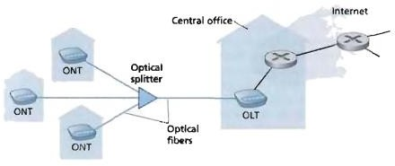
FTTH (Fiber-To-The-Home)

Slide 55
FTTH (Fiber-To-The-Home)
One Fiber leaving the CO (Cen t r a l Office ) for each home.(Direct fiber) provide high band width.
Two optical distribution networks are there – AON and PON.
AON (Active Optical Network)– same as switched Ethernet.
PON (Passive Optical Network) is as follows
OLT : Optical Line Terminator(in Central Office)
converts Optical to electrical signals
ONT: Optical Network Terminator

Slide 56
FTTH (Fiber-To-The-Home)
Each home has an ONT, which is connected by dedicated optical fiber to a neighborhood splitter.
The splitter combines a number of homes(<100) onto a single, shared optical fiber, which connects to an OLT in the telco’s CO.
In the home, users connect a home router to the ONT and access the internet via this home router.
Internet access rates – gigabits/second range.

Slide 57







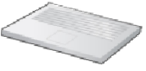


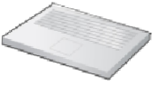


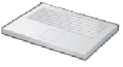








Enterprise access networks (Ethernet)
institutional link to ISP (Internet)
institutional router
Ethernet switch
institutional mail,
web servers
typically used in companies, universities, etc
Popular LAN Technology.
10 Mbps, 100Mbps, 1Gbps, 10Gbps transmission rates.
today, end systems typically connect into Ethernet switch using twisted pair copper wires

Slide 58














Wireless access networks
shared wireless access network connects end system to router
– via base station or “access point”
wide-area wireless access
wireless LANs: (WiFi)
within building (100 ft)
IEEE 802.11 (WiFi), 54 Mbps transmission rate
provided by telco (cellular) operator, 10’s km
between 1 and 10 Mbps
3G, 4G:
to Internet
IEEE 802.16: (WiMAX)
Works with distances of 10’s of kilometers
Operates independent of cellular networks
Provides speed of 5 – 10 mbps or higher
to Internet

Slide 59
Wireless access networks
There are 2 types of wireless internet access
Wireless LAN 2. wide-area wireless access
1. In a wireless LAN, wireless users transmit/receive packets to/from an access point that in turn is connected to the wired internet. Users—within a few tens of meters of the access point.
2. Here, packets are transmitted to a base station over the same wireless infrastructure used for cellular telephony.
Base station managed by the cellular network provider.
Users—within a few tens of kilometres of the base station .

Slide 60






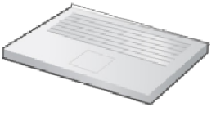




Access net: home network
wireless devices
to/from headend or
central office
often combined in single box
cable or DSL modem
wireless access
router, firewall, NAT
point (54 Mbps)
wired Ethernet (100 Mbps)

Slide 61




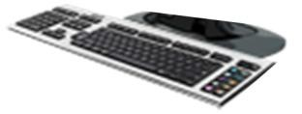
Host: sends packets of data using Physical Media
host sending function:
takes application message
breaks into smaller chunks, known as packets, of length L bits
transmits packet into access network at transmission rate R
– link transmission rate, aka link capacity, aka link bandwidth
two packets,
L bits each
2
1
R: link transmission rate
host

Slide 62
Physical media
For each transmitter-receiver pair, the bit is sent by propagating electromagnetic waves/optical pulses across the physical medium.
Examples --Twisted-pair copper wire, coaxial cable, multimode fiber optic cable, terrestrial radio spectrum and satellite radio spectrum.
Physical media fall into two categories: guided media and unguided media.
guided media:
signals propagate in solid media: copper, fiber, coax
unguided media:
signals propagate freely, e.g., radio, digital satellite channel
Cost of link is very less compared to installation costs

Slide 63
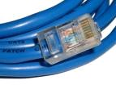
1. Twisted Pair Copper Wire
Least expensive and most widely used guided transmission medium (used in telephone networks).
Two insulated copper wires arranged in spiral pattern.
The wires are twisted to avoid electrical interference.
- UTP (Unshielded Twisted Pair) cables are very common in Computer Networks (LANs and residential internet access)
- Category 3: traditional phone wires, 10 Mbps Ethernet
Category 5: 100 Mbps, 1 Gbps Ethernet
Category 6: 10 Gbps

Slide 64
Twisted Pair (TP)
Twisted pair consists of two insulated copper wires, each about 1 mm thick, arranged in a regular spiral pattern;
a number of pairs are bundled together in a cable by wrapping the pairs in a protective shield. A wire pair constitutes a single communication link.
Two types of UTP are common in LANs: category 3 and category 5.
Category 3 corresponds to voice-grade twisted pair, commonly found in office buildings. 10 Mbps Ethernet
Category 5, with its more twists per centimeter and Teflon insulation, can handle higher bit rates. 100 Mbps Ethernet

Slide 65
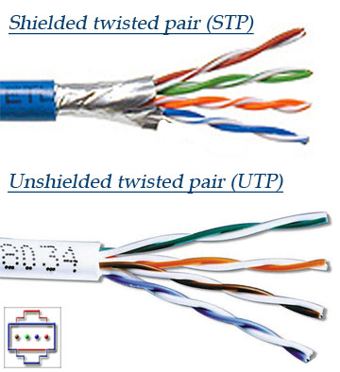

Slide 66
2. Coaxial-Cable
Like twisted pair, coaxial cable consists of two copper conductors, but the two conductors are concentric rather than parallel. With this construction and a special insulation and shielding.
coaxial cable can have higher bit rates than twisted pair.
Coaxial cable comes in two varieties: baseband coaxial cable and broadband coaxial cable.
Both baseband and broadband coaxial cable can be used as a guided shared medium.

Slide 67
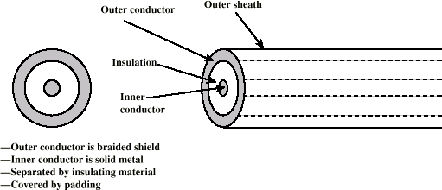
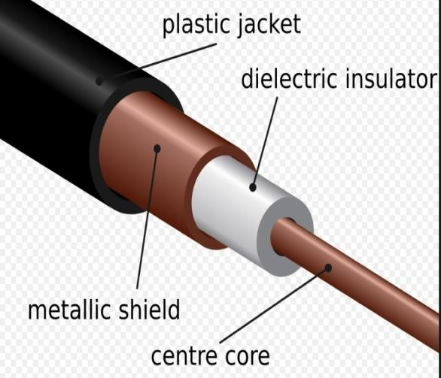
2. Coaxial-Cable
coaxial cable:
two concentric copper conductors
bidirectional
broadband:
multiple channels on cable
HFC
Higher bandwidth than UTP. Up to 500 MHz. Used in cable TV

Slide 68
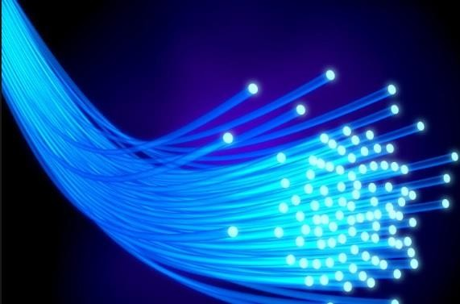
3.Fiber Optics
fiber optic cable:
glass fiber carrying light pulses, each pulse a bit
The light wave propagate by continuous total internal reflection in the fiber
Not affected by external interference
high-speed operation:
high-speed point-to-point transmission (e.g., 10’s-100’s Gbps transmission rate)
low error rate:
repeaters spaced far apart
immune to electromagnetic noise

Slide 69
3.Fiber Optics
An optical fiber is a thin, flexible medium that conducts pulses of light, with each pulse representing a bit.
A single optical fiber can support tremendous bit rates, up to tens or even hundreds of gigabits per second.
They are immune to electromagnetic interference, have very low signal attenuation up to 100 kilometers, and are very hard to tap.

Slide 70
Terrestrial and Satellite Radio Channels
Radio channels carry signals in the electromagnetic spectrum.
They are an attractive media because require no physical "wire" to be installed, can penetrate walls,
provide connectivity to a mobile user, and can potentially carry a signal for long distances.
The characteristics a radio channel depend significantly on the propagation environment and the distance over which a signal is to be carried.

Slide 71
A communication satellite links two or more earth-based microwave transmitter/receivers, known as ground stations.
The satellite receives transmissions on one frequency band, regenerates the signal using a repeater, and transmits the signal on another frequency.
Satellites can provide bandwidths in the gigabit per second range.
Two types of satellites are used in communications: geostationary satellites and low-altitude satellites.

Slide 72
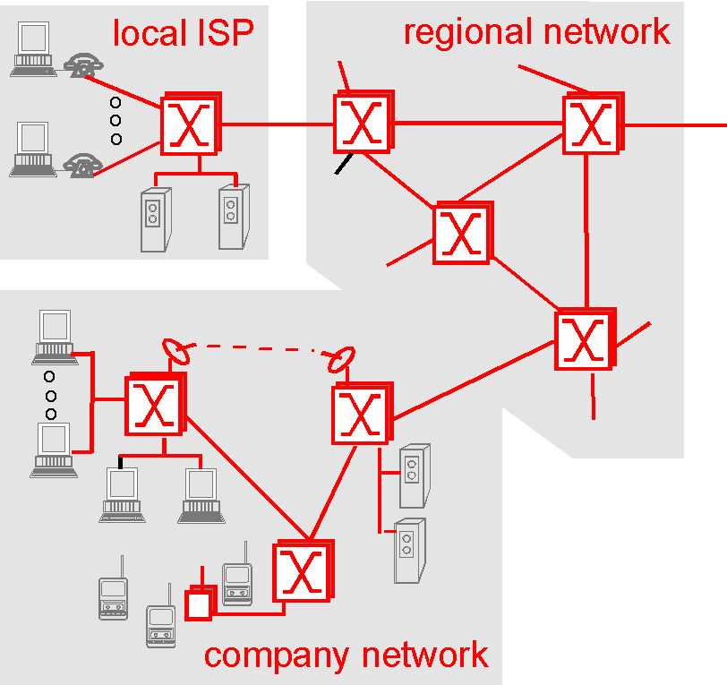
The Network core

Slide 73
The Network core
In this section we study the network core -- the mesh of routers that interconnect the Internet's end systems. Figure highlights the network core in red.

Slide 74
Circuit Switching, Packet Switching
There are two fundamental approaches towards building a network core: circuit switching and packet switching.
In circuit-switched networks, the resources needed along a path (buffers, link bandwidth) to provide for communication between the end systems are reserved for the duration of the session.
In packet-switched networks, these resources are not reserved; a session's messages use the resource on demand, and as a consequence, may have to wait (i.e., queue) for access to a communication link.
Eg- restaurants reservations

Slide 75
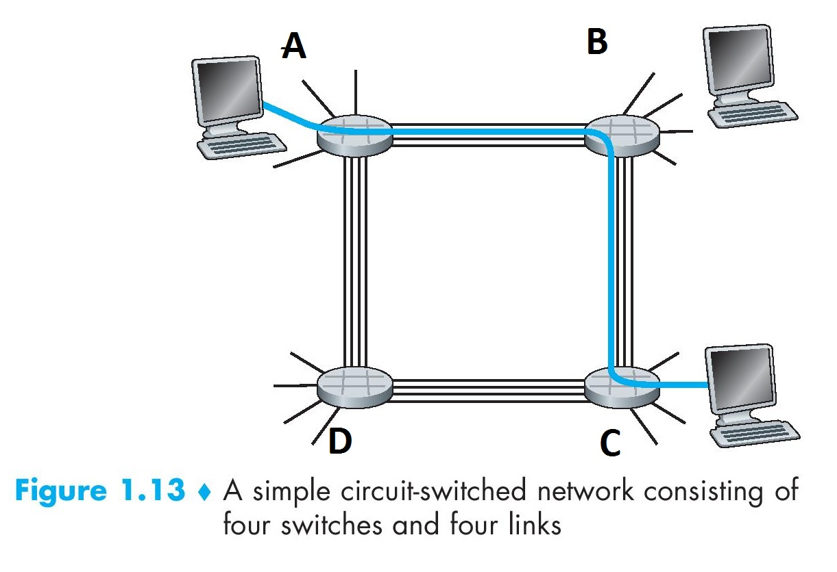
Telephone networks are examples of circuit-switched networks.
Today's Internet is a packet-switched network .

Slide 76
circuit switching
There are 3 phases i) Connection Establishment. ii) Data Transfer. iii) Connection Released.
Here,each data unit know the entire path address which is provided by the source.
Data is processed at source system only.
Delay between data units is uniform.
Resource reservation is the feature of circuit switching because path is fixed for data transmission.
More reliable,Wastage of resources are more.

Slide 77
Packet switching
Directly data transfer takes place .
each data unit just know the final destination address intermediate path is decided by the routers.
Data is processed at all intermediate node including source system.
Delay between data units in packet switching is not uniform.
There is no resource reservation because bandwidth is shared among users.
less reliable, Less wastage of resources .

Slide 78
Multiplexing and Demultiplexing
Multiplexing is the process of sharing the Link bandwidth among different channels by dividing it into pieces and allocating it to individual channels which happens at the sending side.
Demultiplexing is the reverse of that which happens at the receiving side.
There are three types of multiplexing
FDM (Frequency Division Multiplexing),
TDM (Time Division Multiplexing)
Statistical Multiplexing

Slide 79
Multiplexing and Demultiplexing
With FDM, the bandwidth is divided into n pieces and allocated to n channels.
With TDM, the time is divided into n time slots and assigned to each channel in a round robin fashion. Here each channel gets the full bandwidth at the assigned time slot.
Drawback:
If there is no information to communicate after sometime, then the frequency level or the time slot gets wasted.

Slide 80
Multiplexing and Demultiplexing
To overcome the drawback we have Statistical Multiplexing
It is like TDM, but the time slots are assigned to channels on demand

Slide 81
FDM and TDM
Example:
FDM
4 users
frequency
time
TDM
frequency
time

Slide 82


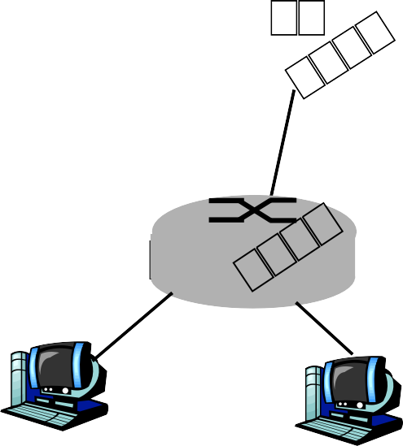


Statistical Multiplexing
10 Mbps
Ethernet
A
C
statistical multiplexing
1.5 Mb/s
B
queue of packets waiting for output link
D
E
Sequence of A & B packets does not have fixed pattern, bandwidth shared on demand statistical multiplexing.

Slide 83
Network Core: Circuit Switching
Circuit switching uses FDM and TDM
With FDM, each circuit continuously gets a Fraction
of the bandwidth. With TDM, each circuit gets all of the bandwidth periodically during brief intervals of time (that is, during slots).

Slide 84
Packet switching versus circuit switching
Packet switching is great for bursty data (internet)
resource sharing
simpler, no call setup
But in case of excessive congestion: packet delay and loss
protocols needed for reliable data transfer, congestion control
Packet switching allows more users to use network!

Slide 85

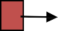


How do loss and delay occur?
packets queue in router buffers
packet arrival rate to link exceeds output link capacity
packets queue, wait for turn
packet being transmitted (delay)
A
B
packets queueing (delay)
free (available) buffers: arriving packets dropped (loss) if no free buffers

Slide 86
Types of delay
Packet suffers from several types of delays at each node along the path.
Important delays are
Nodal processing delay
Queueing delay
3. Transmission delay
4. Propagation delay.
These delays accumulate to give a total nodal delay.

Slide 87

Four sources of packet delay
1. nodal processing:
Time taken for
checking bit errors
determine output link
2. queueing
waiting Time in the queue
depends on congestion level of router
transmission
A
propagation
B
nodal processing
queueing

Slide 88



Delay in packet-switched networks
3. Transmission delay: time taken to transmit the file on to the link
4. Propagation delay: time taken to carry a packet from one end of the link to another
R= link bandwidth (bps)
L= packet length (bits) i.e., size of packet
time to send bits into link =
L/R
d = length of physical link
s = propagation speed in medium (~2x10⁸ m/sec)
propagation delay = d/s
_{A} transmission
propagation
B
nodal processing
queueing

Slide 89
(nodal )processing delay: The time required to examine the packet’s header and determine where to direct the packet is part of the processing delay.
Time taken for -checking bit errors
-determine output link
2. Queueing delay
waiting Time in the queue
depends on congestion level of router

Slide 90
3.Transmission delay: Time taken to transmit the file on to the link
R= link bandwidth (bps)
L= packet length (bits) i.e., size of packet
Time to send bits into link = L / R
4. Propagation delay: Time taken to carry a packet from one end of the link to another
d = length of physical link
s = propagation speed in medium (~2x10⁸ meters/sec)
propagation delay = d / s

Slide 91
Nodal delay
^{d}nodal ^{= d}proc ^{+ d}queue ^{+ d}trans ^{+ d}prop
d_{proc} = processing delay
typically a few microsecs or less
d_{queue} = queuing delay
depends on congestion
d_{trans} = transmission delay
– = L/R, significant for low-speed links
d_{prop} = propagation delay
a few microsecs to hundreds of msecs

Slide 92




Caravan analogy
100 km
100 km
ten-car caravan
toll booth
toll booth
Time to “push” entire caravan through toll booth onto highway = 12*10 = 120 sec
Time for last car to propagate from 1st to 2nd toll both: 100km/(100km/hr)= 1 hr
A: 62 minutes
cars “propagate” at
100 km/hr
toll booth takes 12 sec to service car (transmission time)
car~bit; caravan ~ packet
Q: How long until caravan is lined up before 2nd toll booth?

Slide 93
Caravan analogy (more)
100 km
100 km
ten-car caravan
toll booth
toll booth
Yes! After 7 min, 1st car at 2nd booth and 3 cars still at 1st booth.
1st bit of packet can arrive at 2nd router before packet is fully transmitted at 1st router!
Cars now “propagate” at
1000 km/hr
Toll booth now takes 1 min
to service a car
Q: Will cars arrive to 2nd booth before all cars serviced at 1st booth?
Notes:
6 mint required from toll1 to toll2

Slide 94
Problem 1
How long does it take to propagate a file of size 2.5KB over a link of distance 3000km. The propagation speed is 2.5*10⁸ m/sec and transmission rate is 5Mbps. There is no processing delay and the data packets can be sent continuously (no queuing delay)?
Propagation delay = d/s
= 3000 X 1000 / (2.5 X POW(10,8))
= 0.012 secs

Slide 95
Transmission delay = L/R
= (2.5 X pow(2,10) X 8) / (5 X pow(10,6))
= 0.004096 secs
Total Delay = Propagation delay + Transmission delay + processing delay + queueing delay
Total delay = 0.016096 secs

Slide 96
Problems 2
How long does it take to propagate a file of size 1.5KB over a link of distance 5000km. The propagation speed is 2.5*10⁸ m/sec and transmission rate is 5Mbps. There is no processing delay and the data packets can be sent continuously (no queuing delay)?
Propagation delay = d / s
= 5000 X 1000 / (2.5 X POW(10,8))
= 0.2 secs

Slide 97
Transmission delay = L/R
= (1.5 X pow(2,10) X 8) / (5 X pow(10,6))
= 0.0012 secs
Total Delay = Propagation delay + Transmission delay + processing delay + queueing delay
Total delay = 0.2012 secs

Slide 98
Throughput
How much data can be transferred from one location to another in a given amount of time.
It is used to measure the performance of Internet and network connections.
The effective end-to-end throughput that can be achieved over a network is given by
Throughput = Transfer Size / Transfer Time.

Slide 99
PROTOCOL LAYERING
Internet is protocol .
A protocol defines the rules that both the sender and receiver and all intermediate devices need to follow to be able to communicate effectively.
When communication is simple, we may need only one simple protocol;
when the communication is complex, we need a protocol at each layer, or protocol layering.

Slide 100









A single-layer protocol
Need for protocol layering.
First Scenario (two people are talking)

Slide 101
A single-layer protocol
Anna and Maria are neighbours with lot of common ideas.( Communication is simple.)
Communication takes place in one layer, face to face, same language. Set of rules needs to be followed.
They should greet each other
They should confine their vocabulary to the level of their friendship.
Each party should refrain from speaking when the other party is speaking.
Conversion should be a dialog, not a monologue.
Exchange some nice words when they leave.

Slide 102








A three-layer protocol
Second Scenario (Ann got promoted and transferred to another branch
located in a far off city)
Postal carrier facility

Slide 103
A three-layer protocol
Using mail through the post office.
They do not want their ideas to be revealed by other people---encryption/decryption Technique.
Communication takes place in 3 layers.
Each have 3 machines that can perform the task at each layer.
Protocol layering enables us to divide complex task into several smaller/simpler task.(modularity)

Slide 104















Why protocol layering
protocol layering enables us to divide a complex task into several smaller and simpler tasks
Provides modularity (changing a module is easy)
It separates services from implementation
All nodes (eg. Routers) does not require all layers
97

Slide 105
Principles of Protocol Layering
If we want bidirectional communication, we need to make each layer so that it is able to perform two opposite tasks, one in each direction.
Eg-The third layer task is to listen(in one direction) and talk (in the other direction).The 2nd layer needs to be able to encrypt/decrypt. The first layer needs to send and receive mail.
Two objects under each layer at both sites should be identical
Eg—The object under layer-3 at both sites should be a plaintext letter. The object under layer-2 at both sites should be a ciphertext letter. Under layer-1 at both sites should be a piece of mail.

Slide 106

Logical connection between peer layers
Between layers it is bidirectional communication. Every layer is capable of receive/send information.

Slide 107
TCP/IP Protocol Suite
TCP/IP is a protocol suite used in the Internet today. It is a hierarchical protocol made up of interactive modules, each of which provides a specific functionality.
The term hierarchical means that each upper level protocol is supported by the services provided by one or more lower level protocols.
The original TCP/IP protocol suite was defined as four software layers built upon the hardware. Today, however, TCP/IP is thought of as a five-layer model.

Slide 108
Layers in the TCP/IP protocol suite

Slide 109
Communication through an internet
How the layers in the TCP/IP protocol suite are involved in communication between 2 hosts as shown in fig.
Computer A communicates with computer B, 5 Communicating devices.
Each device is involved with a set of layers depending on the role of the device in the internet.

Slide 110



Layered Architecture :- Communication through an internet
Different devices contains different number of layers depending on their role

Slide 111






Logical connections between layers in TCP/IP
Logical connections

Slide 112
Logical connections between layers in TCP/IP
Using logical connections the duty of each layer-makes it easier.
The duty of the application, transport and network layers is end-to-end.
The duty of the data-link and physical layers is hop-to-hop(router/host).
The domain of duty of the top three layers
is the internet, The domain of duty of the two lower layers is the link.

Slide 113

Identical objects in the TCP/IP protocol suite
Identical objects (messages)
Identical objects (segment or user datagram)
Identical objects (datagram)
Identical objects (datagram)
Identical objects (frame)
Identical objects (frame)
Identical objects (bits)
Identical objects (bits)

Slide 114
Identical objects in the TCP/IP protocol suite
The logical connection at the network layer is between the two hosts.
Identical objects exist between 2 hops in this case because a router may fragment the packet at the network layer and send more packets than received.
Note that the link between 2 hops does not change the object.

Slide 115
Description of each layer in TCP/IP

Slide 116
Application layer
It is the top most layer of TCP/IP model.
Application layer defines TCP/IP application protocols and how host programs interface with Transport layer services to use the network.
Application layer includes all the higher-level protocols like HTTP,DNS,SMPT,FTP….

Slide 117
Application layer
HTTP (Hypertext Transfer Protocol)—is a vehicle or accessing the world wide web(WWW) .
SMTP (Simple Mail Transfer Protocol) --is the main protocol used in electronic mail(e-mail) service.
FTP (File Transfer Protocol)—is used for transferring files from one host to another.
TELNET(Terminal Network) and SSH (Secure Shell) are user for accessing a site remotely.

Slide 118
SNMP (Simple Network Management Protocol)—is used by an administrator to manage the Internet at global and local levels.
DNS (Domain Naming System),--is used by other protocols to find the network-layer address of a computer.
IGMP(Internet Group Management Protocol)—is used to collect membership in a group.

Slide 119
Application layer
Logical connection between the 2 application layers is end-to-end.
Communication is between two running programs.
They exchange messages(communication is done through all the layers).
Process-to-process communication is the duty of the application layer.

Slide 120
Transport Layer
Transport Layer at the source, host gets the message from the application layer, encapsulates it in a segment/user datagram and send it through the logical connection, to the transport layer at the destination host.
Transport Layer is independent of application layer.
process-process data transfer
TCP (Connection oriented),
UDP(Connectionless),
SCTP(Stream Control Transmission Protocol)

Slide 121
Transmission control protocol (TCP) is a connection oriented protocol that first establishes a logical connection between the transport layers at two host before transferring data.
It creates a logical pipe between 2 TCPs for transferring a stream of bytes.
TCP provides flow control ,error control and the congestion control to reduce the loss of segments due to congestion in the network.

Slide 122
User data protocol(UDP), is a connectionless protocol that transmit the user datagram without first creating the logical connection.
It is attractive to an application program that needs to send short messages
A new protocol, Stream Control Transmission Protocol (SCTP) is designed to respond to new application that are emerging in the multimedia.

Slide 123
Network Layer
It is responsible for creating connection from source computer to destination computer.
Host-to-Host connectivity.
Choosing the best path for each packet.
Routing of packets through possible routes
Addressing
Routing
IP(main protocol), routing protocols(Unicast, Multicast), Companion Protocols (ICMP, IGMP, DHCP, ARP)

Slide 124
Network Layer
Internet protocol, that defines the format of the packet, called a datagram at the network layer. IP also define the format and the structure of addresses used in the layer.
IP is also responsible for routing a packet from its source to its destination, which is achieved by each router forwarding the datagram to the next router in the path.

Slide 125
Network Layer
IP is a connectionless protocol that provides no flow control, no error control, and no congestion control services.
The Internet Control Message Protocol(ICMP) helps IP to report some problems when routing a packet.
The Internet Group Management Protocol (IGMP)is another protocol that helps IP in multitasking.

Slide 126
Network Layer
The Dynamic Host Configuration Protocol (DHCP) helps IP to get the network layer address for the host.
The Address Resolution Protocol (ARP) is the protocol that helps IP to find the link-layer address of a host or a router when its network address is given.

Slide 127
Data Link Layer
The data link layer is responsible for taking the datagram and moving it across the link.
The link can be a wired LAN with a link-layer switch, a wireless LAN, a wired WAN, or a wireless WAN.
The data link layer takes the datagram and encapsulates it in a packet called frame.
Each link layer protocol may provide a different service. Some link layer protocol provide complete error detection and correction.

Slide 128
Physical Layer
The physical layer is responsible for carrying individual bits in a frame across the link.
Bits “on the wire”
Physical layer protocols transform the bits into signals that flows through the medium.
There are several protocol that transforms a bit to a signal.
Protocol is used to connect to the host, so that the packets can be sent over it.

Slide 129
Encapsulation and Decapsulation
One of the important concept in protocol layering in the internet is Encapsulation / Decapsulation.
Encapsulation at the Source Host –
At the application layer, the data to be exchanged referred as a message (no header/trailer).
At the transport layer, takes the message as the payload, adds header(identifiers of the source and destination application programs, information for flow, error control, congestion control). Transport layer packet is called segment.

Slide 130
3. At the network layer, adds the header(contains addresses of the source and destination hosts, error checking information ). The result of network layer packet is called a datagram.
4. At the data-link layer, adds the header (contains link-layer addresses of the host or the next hop(router)). The result of data-link layer packet is called a frame.
5.The frame is passed to the physical layer for transmission.--bits

Slide 131
Decapsulation and Encapsulation at Router.
After the set of bits are delivered to the data –link layer, this layer decapsulates the datagram from the frame and passes it to the network layer.
The network layer inspects the source and destination address, to find the next hop. The datagram is then passed to the data-link layer of the next link.
The data-link layer encapsulates the datagram in a frame and passes it to the physical layer for transmission.
Decapsulation at the Destination Host.
Each layer only decapsulates the packet, removes the payload,delivers to next-higher layer,error checking.

Slide 132








Figure 1.16: Encapsulation / Decapsulation

Slide 133
Addressing
Any communication between two parties needs two addresses.
Source address and Destination address
One pair per layer
Normally, (We have four pairs of addresses)
have only four because the physical layer does not need addresses.
At the application layer , normally use names to define the site that provides services, such as someorg.com. The email address, such assomebody@coldmail.com

Slide 134
At the transport layer, addresses are called port numbers, and these define the application-layer programs at the source and the destination.
Port number are local addresses that distinguish between several programs running at the same time.

Slide 135
At the network layer , the addresses are global, with the whole internet as the scope.
A network layer addresses uniquely defines the connection of a device to the internet.
The link-layer addresses, sometimes called MAC addresses, are locally defined addresses, each of which defines a specific host or router in a network(LAN or WAN).

Slide 136


Addressing in the TCP/IP protocol suite

Slide 137
Through logical address the system identify a network (source to destination). after identifying the network physical address is used to identify the host on that network. The port address is used to identify the particular application running on the destination machine. Logical Address: An IP address of the system is called logical address. This address is the combination of Net ID and Host ID. This address is used by network layer to identify a particular network (source to destination) among the networks. This address can be changed by changing the host position on the network. So it is called logical address.

Slide 138
Physical address: Each system having a NIC(Network Interface Card) through which two systems physically connected with each other with cables. The address of the NIC is called Physical address or mac address. This is specified by the manufacture company of the card. This address is used by data link layer.
Port Address: There are many application running on the computer. Each application run with a port no.(logically) on the computer. This port no. for application is decided by the Karnal of the OS. This port no. is called port address.

Slide 139































Multiplexing and Demultiplexing
Multiplexing – a protocol at a layer can encapsulate a packet from several next higher layer protocols
Demultiplexing – a protocol can decapsulate and deliver a packet to several next higher layer protocols

Slide 140


Figure 1.18: Multiplexing and demultiplexing

Slide 141
The OSI Model
Established in 1947, ISO (International Organization for Standardization) is a multinational body dedicated to worldwide agreement on international standards. An ISO standard that covers all aspects of network communications is the Open Systems Interconnection (OSI) model. It was first introduced in the late 1970s.
- Open : Two different systems can communicate regardless of their underlying architecture
OSI versus TCP/IP: 2 layers are missing
some functionalities of session layer may be available in some of the transport layer protocol
application layer is not just one piece, many applications could be there.

Slide 142

Figure 1.19: The OSI model

Slide 143

TCP/IP and OSI model

Slide 144
The OSI Model
Lack of OSI Model’s Success
TCP/IP in already implemented, up and running.
protocols for session and presentation layers are not clearly defined.
not a significant performance boost for switch over.

Slide 145
OSI Model
The Open System Interconnection (OSI) reference model describes how the information moves from one computer to another computer through a network.
This model was developed by the International Organization for Standardization (ISO) in 1984.
This model is used for understanding and designing a network architecture that is flexible, robust and inter-operable.

Slide 146
OSI Model
OSI model has seven separate but related layers : Physical, Data link, Network, Transport, Session, Presentation and Application.
Each layer defines a part of the process of moving information across the network.

Slide 147

OSI Model

Slide 148
1. Physical layer:
Physical layer is the lowest layer of the OSI model.
It coordinates the function required to transmit a bit stream over a communication channel.
It defines the procedures and functions that physical devices and interfaces have to perform for transmission.
Physical layer also defines the direction of transmission between two devices. Direction may be simplex, full-duplex and half-duplex.

Slide 149
2. Data link layer
Data link layer is responsible for transmitting the data over the channels.
It is used to divide the stream of bits received from the network layer into manageable data units called frames.
It adds a header to the frame to define the sender and receiver of the frame.
Data link layer detects and corrects the transmission errors using the correction method.

Slide 150
3. Network layer
The network layer is responsible for the delivery of a packet, across multiple network.
It specifies the intra-network operations and different types of addressing and routing devices.
Network layer also provides the logical and service addressing and switching control.

Slide 151
4.Transport layer
The transport layer specifies the process to process delivery of the entire message.
It is responsible for flow control and error control.
The transport layer of sending device makes sure that the entire message arrives at the transport layer of receiving device without error.

Slide 152
5. Session layer
Session layer is the network dialog controller.
It is used to establish, maintain and synchronize the interaction among communicating system.
Specific responsibility of session layer is dialog control.

Slide 153
6. Presentation layer
The presentation layer is responsible to translate the information into bit streams before transmission.
It is also responsible for data encryption, data decryption and data comprehension.

Slide 154
7. Application layer
Application layer allows the user, whether human or software, to access the network.
This layer provides user interfaces and application services for file transfers, e-mail, and other network software services.

Slide 155


